Slide 1
Python

Slide 2

Intro to Programming with Python
Software
Software is a set of instructions to the hardware.
Programming
Programming means writing the instructions to create a software.
Code
The instructions that we write to create software is called Code.
Syntax
Similar to Grammar rules in English, Hindi, each programming language has a unique set of rules. These rules are called the Syntax of a Programming Language.

Slide 3
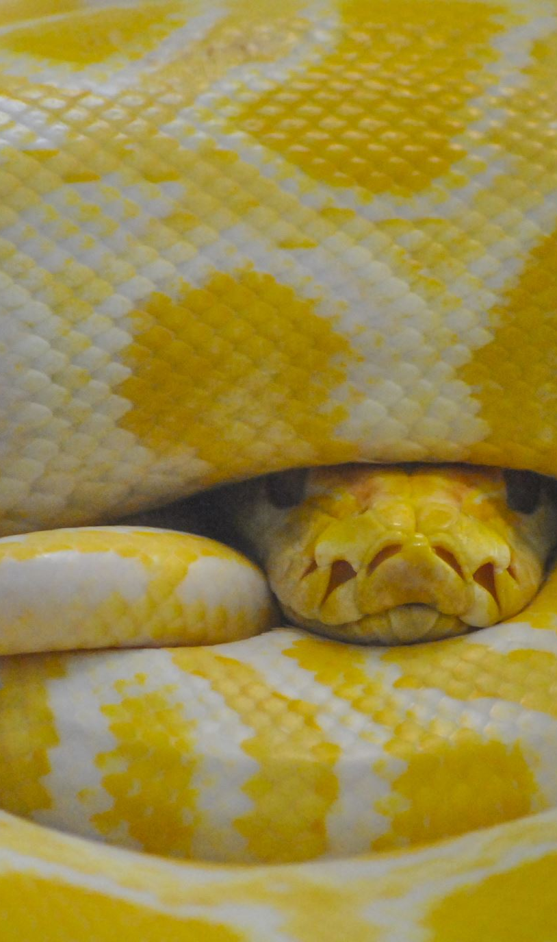
Why Python
Python is an easy to learn, powerful programming language. With Python, it is possible to create programs with minimal amount of code. Look at the code in Java and Python used for printing the message "Hello World“
class Main {
public static void main(String[] args)
{ <------JAVA
System.out.println("Hello World");
}
}
-------------------------------------------------------------
print("Hello World") <------PYTHON

Slide 4

Applications of Python
Python is a versatile language which has applications in almost every field
Artificial intelligence (AI)
Machine Learning (ML)
Big Data
Smart Devices/Internet of Things (IoT)
Cyber Security
Game Development
Backend Development, etc.

Slide 5

Career Opportunities
Python developers have plenty of opportunities across the world
DevOps Engineer
Software Developer
Data Analyst
Data Scientist
Machine Learning (ML) Engineer
AI Scientist, etc.

Slide 6
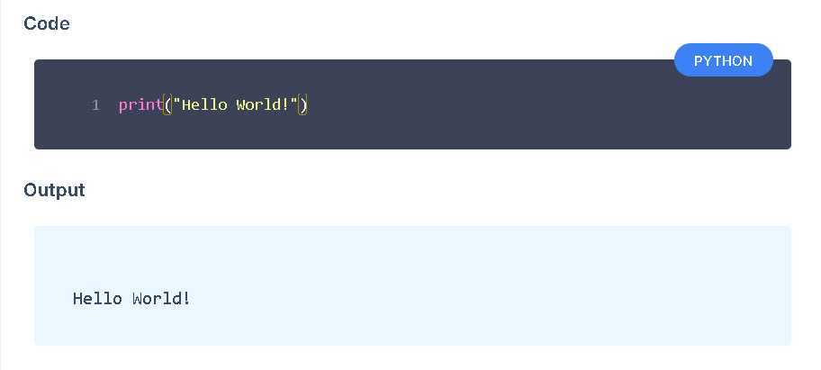
Hello World Program in Python
Here is a simple Python code that you can use to display the message "Hello World“

Slide 7

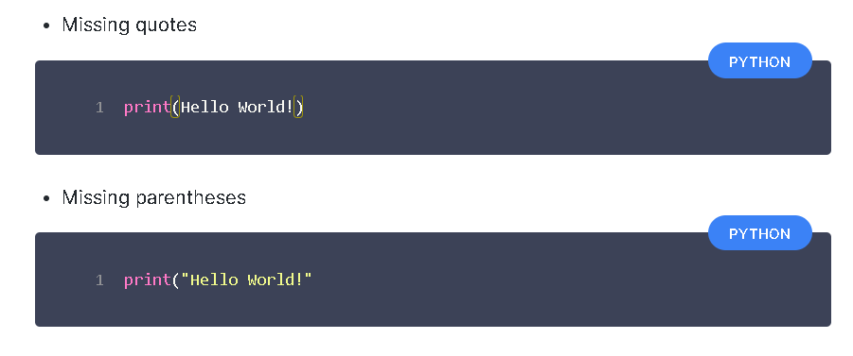
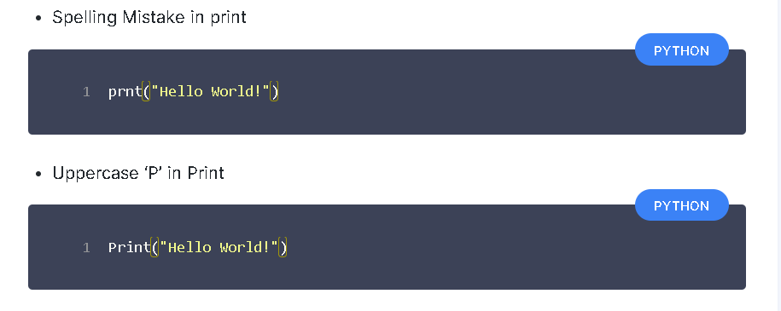
Possible Mistakes
Possible mistakes you may make while writing Python code to display the message "Hello World“

Slide 8
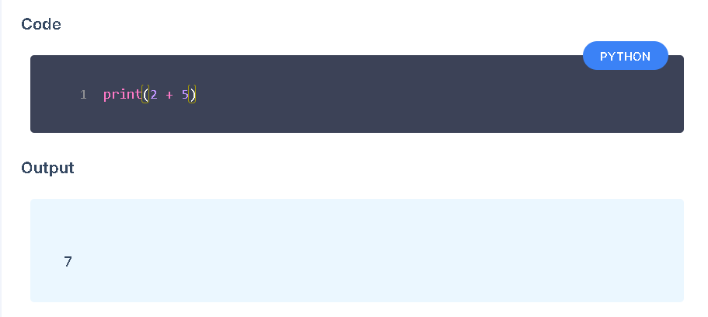
Printing Without Quotes
If we want to print the numerical result of 2 + 5, we do not add quotes.

Slide 9
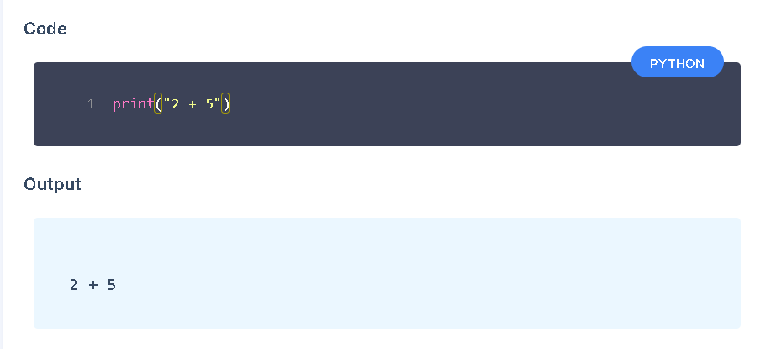
If we want to print the exact message "2 + 5", then we add the quotes.

Slide 10
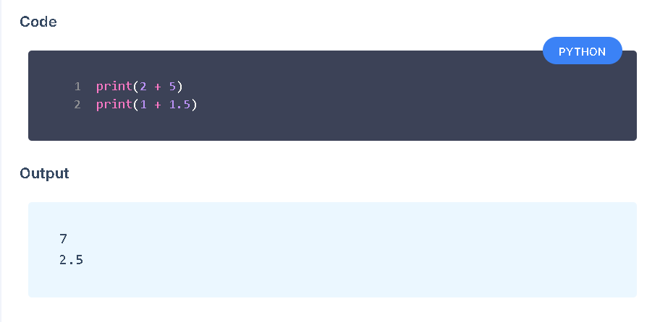
Calculations with python
Addition
Addition is denoted by + sign.
It gives the sum of two numbers.

Slide 11
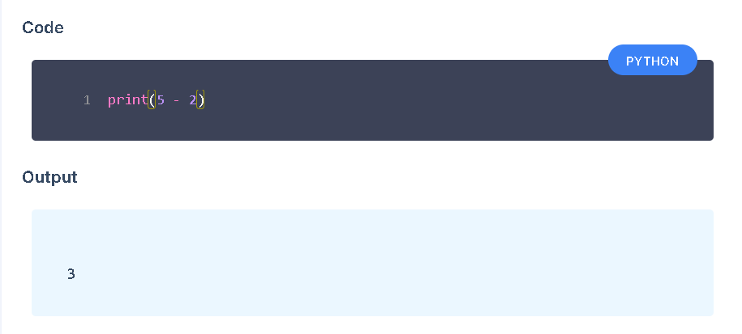
Subtraction
Subtraction is denoted by - sign.
It gives the difference between two numbers.

Slide 12
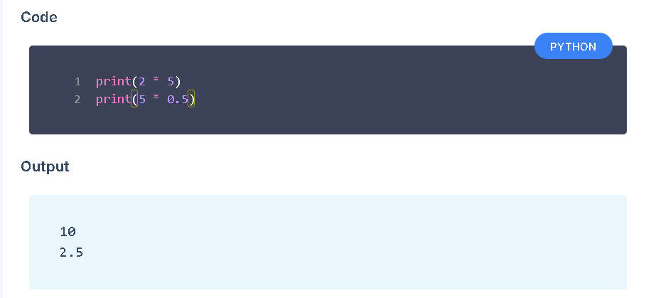
Multiplication
Multiplication is denoted by * sign.

Slide 13
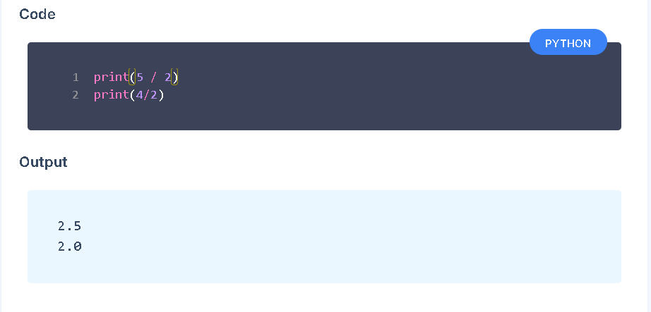
Division
Division is denoted by / sign.

Slide 14
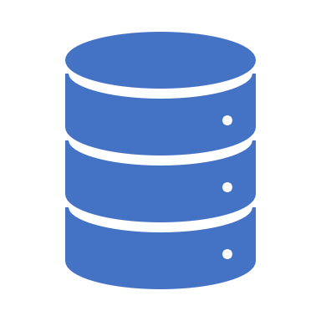
Variables and Data Types
Variables
Variables are like containers for storing values.
Values in the variables can be changed.
Values
Consider that variables are like containers for storing information.
In context of programming, this information is often referred to as value.

Slide 15
Data Type
In programming languages, every value or data has an associated type to it known as data type.
Some commonly used data types
String
Integer
Float
Boolean
This data type determines how the value or data can be used in the program. For example, mathematical operations can be done on Integer and Float types of data.

Slide 16
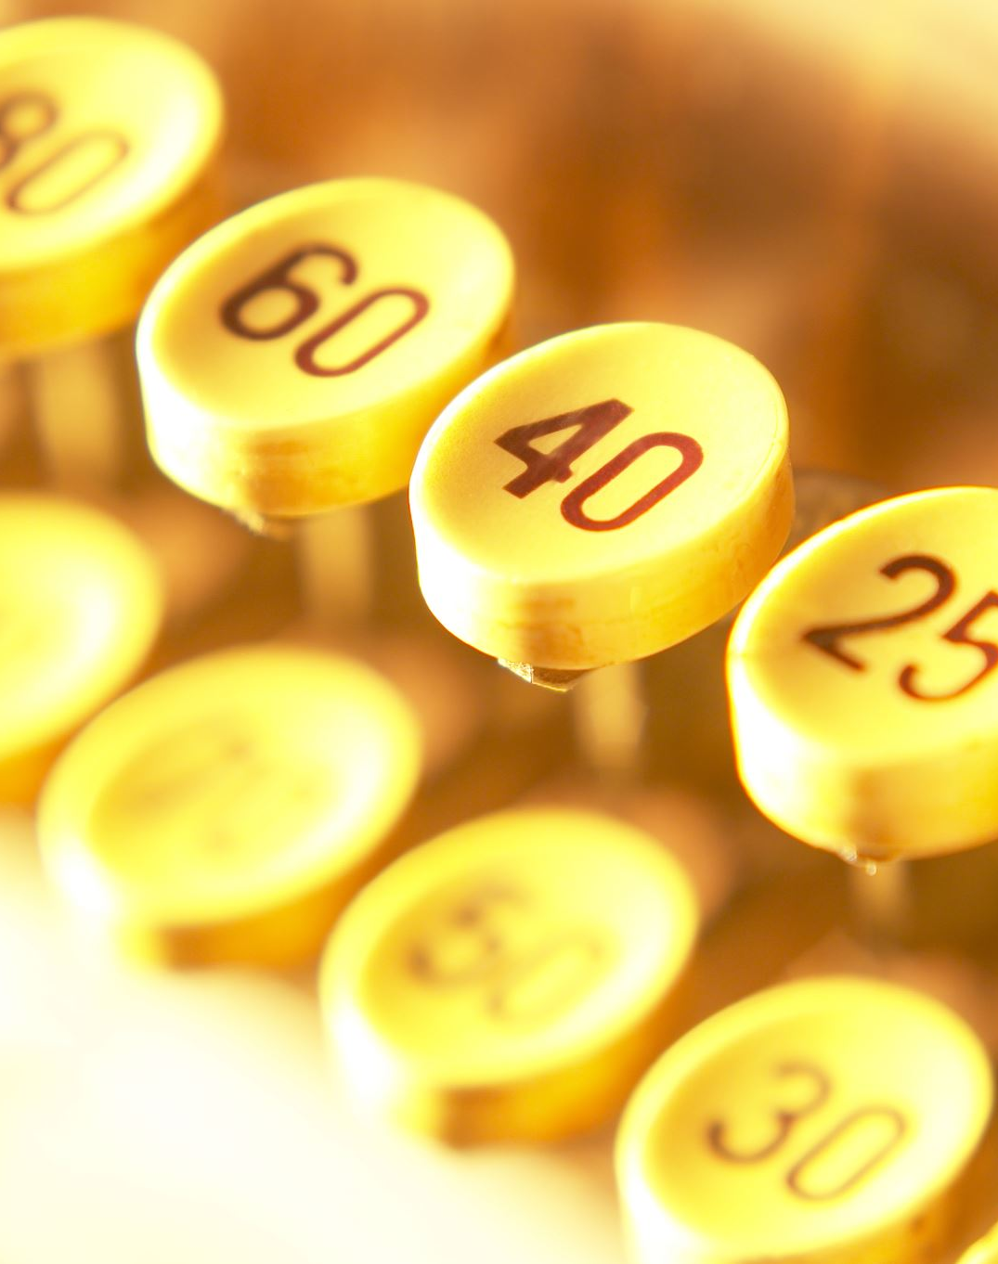
String
A String is a stream of characters enclosed within quotes.
Stream of Characters
Capital Letters ( A – Z )
Small Letters ( a – z )
Digits ( 0 – 9 )
Special Characters (~ ! @ # $ % ^ . ?,)
Space
Some Examples
"Hello World!"
"some@example.com"
"1234"

Slide 17
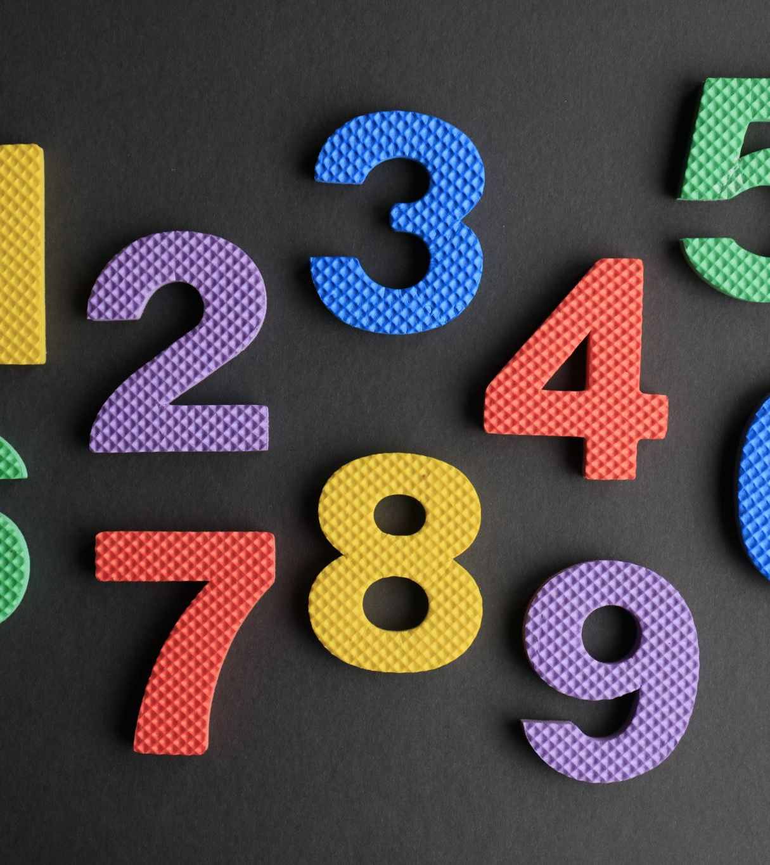
Integer
All whole numbers (positive, negative and zero) without any fractional part come under Integers.
Examples
...-3, -2, -1, 0, 1, 2, 3,...

Slide 18

Float
Any number with a decimal point
Examples
24.3, 345.210, -321.86

Slide 19

Boolean
In a general sense, anything that can take one of two possible values is considered a Boolean. Examples include the data that can take values like
True or False
Yes or No
0 or 1
On or Off , etc.
As per the Python Syntax, True and False are considered as Boolean values. Notice that both start with a capital letter.

Slide 20
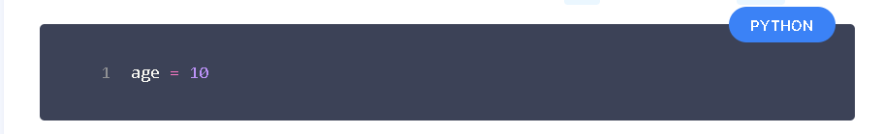
Assigning Value to Variable
The following is the syntax for assigning an integer value 10 to a variable age
Here the equals to = sign is called as Assignment Operator as it is used to assign values to variables.

